Slide 1
Applied aspect of nerve and muscle
Date: 05-11-2025
Dr. Yerra Vishnu Akhil Raj Kumar
Senior Resident, AIIMS Bibinagar
MBBS- AIIMS Patna
Bio-Design Fellow- IIT Hyderabad
MD Physiology- AIIMS Raipur

Slide 2
Contents
Nobel Prize
Myasthenia Gravis
Lambert Eaton Syndrome
Organophosphate poisoning
Diptheria Toxin
Strychnine poisoning
Tetanus Toxin
Botulism toxin and botox
Polio
Motor neuron disease

Slide 3
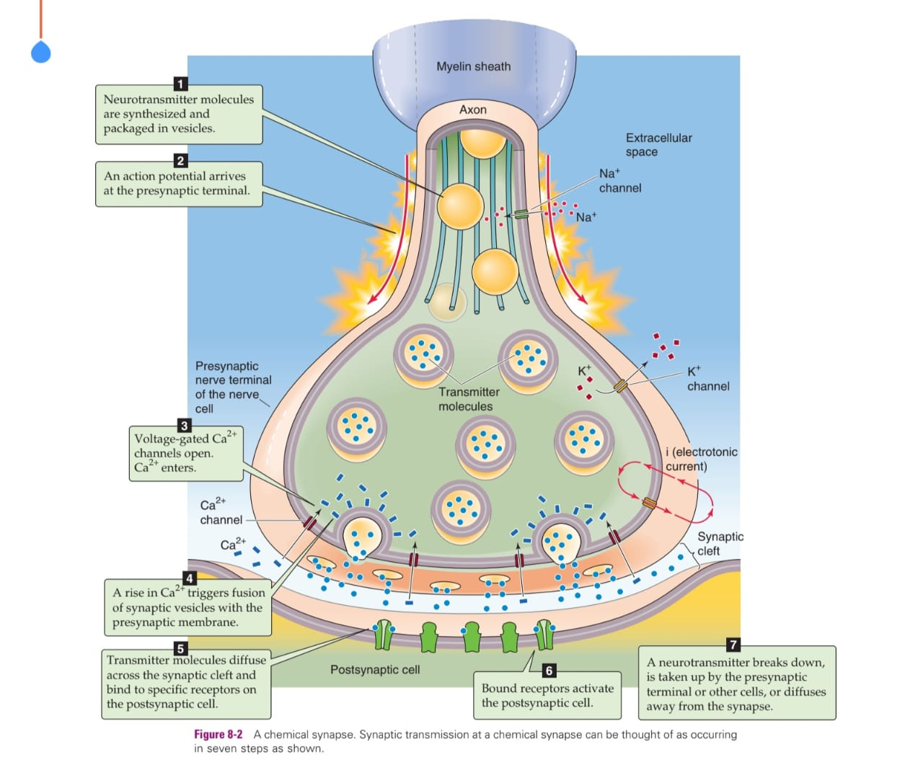

Slide 4
1. NSF
N-ethylmaleimide Sensitive Factor
An ATPase enzyme
Helps disassemble SNARE complexes after vesicle fusion (recycling machinery)

Slide 5
2. SNAP
Soluble NSF Attachment Protein
Acts like an adapter
Helps NSF bind to the SNARE complex
Without SNAP, NSF cannot work

Slide 6
3. SNARE Proteins (Types)
SNAREs are Soluble NSF Attachment Protein Receptors They are of two main types:
A. v-SNARE (Vesicle SNARE)
Located on vesicle membrane Main example:
Synaptobrevin (also called VAMP: Vesicle-Associated Membrane Protein)
Function: Vesicle-side protein that binds to t-SNAREs on the target membrane.

Slide 7
B. t-SNARE (Target SNARE)
Located on presynaptic terminal (plasma membrane) Main examples:
Syntaxin
SNAP-25
Function: Form the docking complex with v-SNARE to pull membranes together.

Slide 8
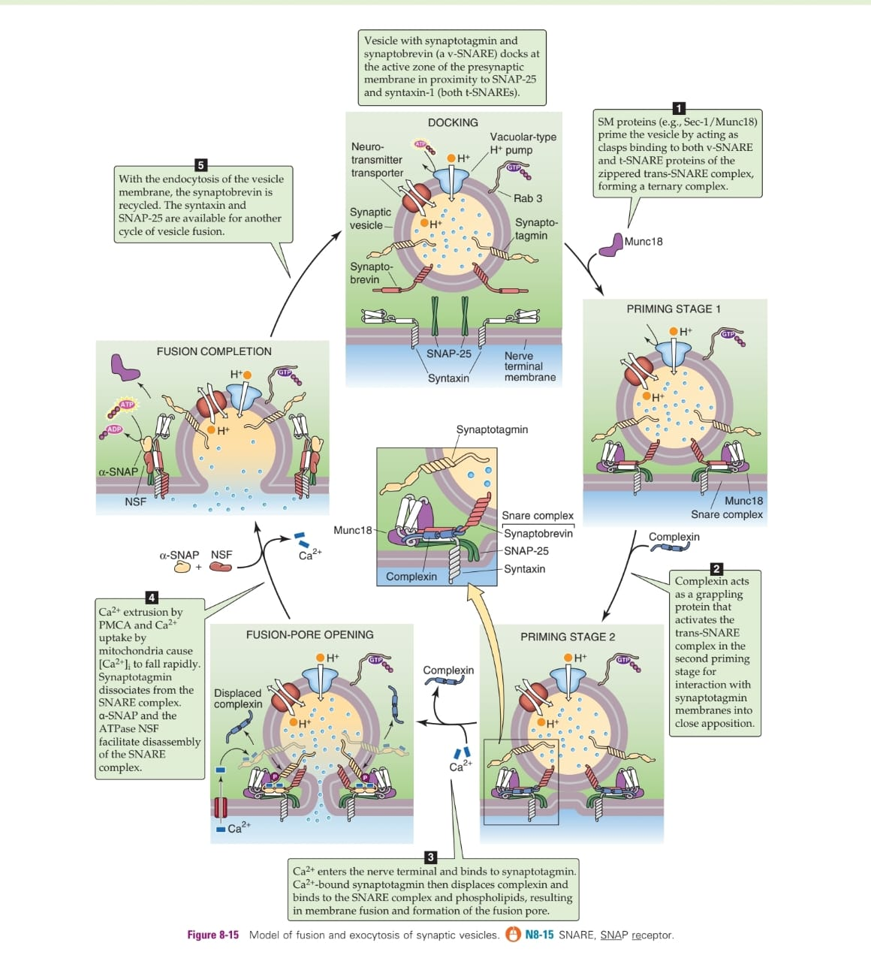

Slide 9
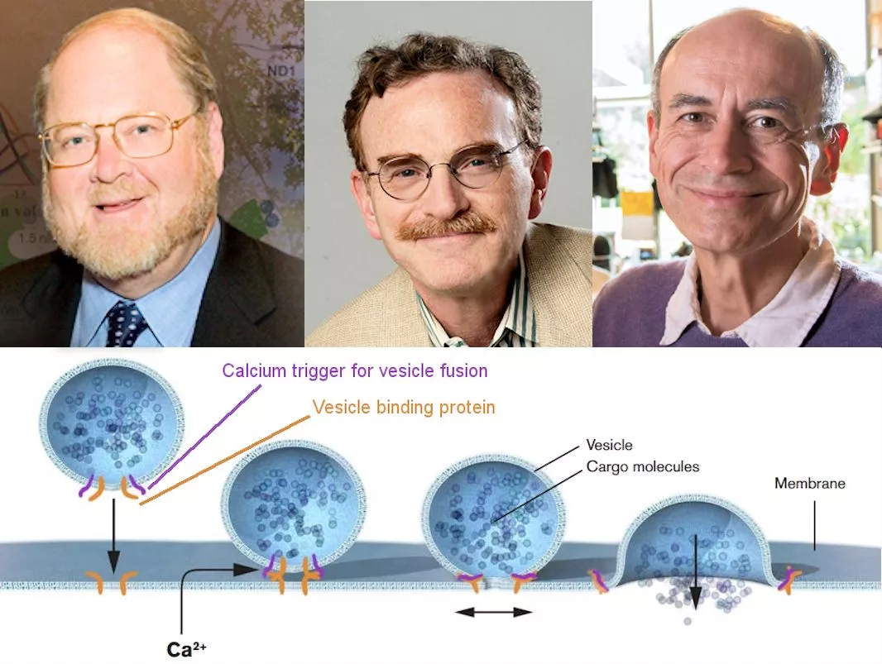
2013 Nobel prize

Slide 10
Scientist | Discovery | Channel/Protein involved | Simple Explanation
Randy Schekman | Genes that control vesicle formation & transport | COPI/COPII vesicle proteins | How vesicles move inside the cell
James Rothman | SNARE complex mechanism of vesicle fusion | SNARE proteins: Synaptobrevin, Syntaxin, SNAP-25 | How neurotransmitter vesicles fuse with membrane
Thomas Südhof | Calcium-triggered neurotransmitter release | Synaptotagmin (Ca²⁺ sensor) | Ca²⁺ binds synaptotagmin → ACh released

Slide 11
Myasthenia Gravis
Site: POST-SYNAPTIC NMJ dysfunction Defect: Autoantibodies destroy ACh receptors (nAChR) Channel: Nicotinic ACh receptor blocked End result: ↓ end-plate potential → muscle fatigability
Simple symptoms:
Ptosis, diplopia
Fatigue on repeated use
Improves with rest
Bulbar weakness (dysphagia)

Slide 12


Slide 13
Lambert-Eaton Myasthenic Syndrome (LEMS)
Site: PRE-SYNAPTIC terminal Defect: Autoantibodies against Voltage-gated Ca²⁺ channels (P/Q-type) Channel involved: Ca²⁺ channels blocked End result: ↓ Ca²⁺ entry → ↓ ACh release
Simple symptoms:
Proximal muscle weakness
Improves with repeated effort (facilitation)
Dry mouth (autonomic)
Often associated with small cell lung cancer

Slide 14
Organophosphate Poisoning
Organophosphates irreversibly inhibit acetylcholinesterase (AChE) → ACh cannot be broken down → Excess ACh accumulates at synapses
Where is the Defect?
Synaptic cleft (post-ganglionic parasympathetic & NMJ) Also affects CNS and autonomic ganglia

Slide 15
Which Channel / Protein is Involved?
Acetylcholinesterase (AChE) enzyme inhibited (No direct ion channel block)
Leads to overactivation of:
Muscarinic receptors (M1–M5)
Nicotinic receptors (NMJ + ganglia)
End Result
Continuous stimulation of muscarinic, nicotinic, and CNS cholinergic pathways
Cholinergic crisis → both muscarinic excess and paralysis

Slide 16
Simple Clinical Features
Muscarinic (DUMBBELSS):
Diarrhea
Urination
Miosis (pinpoint pupils)
Bronchospasm
Bradycardia
Emesis
Lacrimation
Sweating
Salivation

Slide 17
Nicotinic:
Muscle fasciculations → weakness → paralysis
CNS:
Anxiety
Convulsions
Coma
Respiratory failure

Slide 18


Slide 19
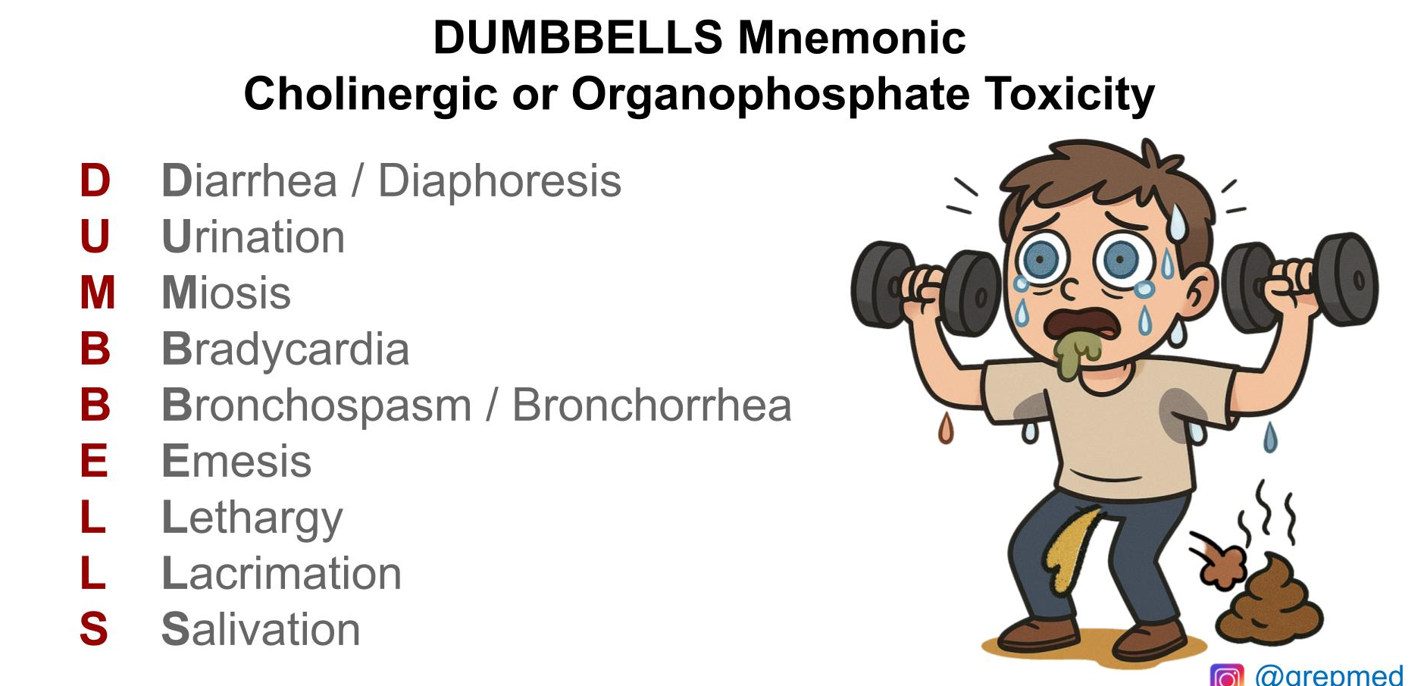

Slide 20
Botulinum Toxin
What Happens? (Defect)
Botulinum toxin blocks neurotransmitter (ACh) release at the neuromuscular junction.
Where is the Defect?
Pre-synaptic terminal → prevents fusion of ACh vesicles with membrane
Which Channel / Protein is Involved?
Toxin cleaves SNARE proteins:
Synaptobrevin (VAMP – v-SNARE)
SNAP-25 (t-SNARE)
Syntaxin (t-SNARE)
Result: Vesicle cannot fuse → no ACh release

Slide 21
End Result
Flaccid paralysis (first cranial, then descending)
Loss of neuromuscular transmission
No muscle contraction
Simple Clinical Features
Blurred vision, diplopia
Ptosis
Dilated pupils
Dysphagia, dysarthria
Descending symmetrical weakness
Respiratory muscle paralysis (most dangerous)
Key Point (Exam Line)
Botulinum toxin = Pre-synaptic SNARE cleavage → NO ACh release → Flaccid paralysis

Slide 22
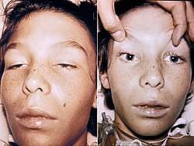

Slide 23
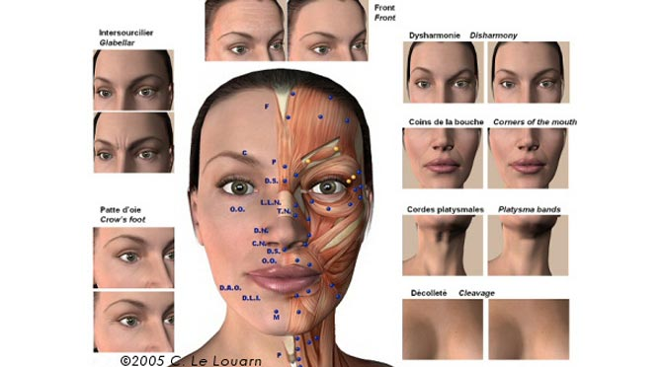
Botox injection

Slide 24
Diptheria Toxin
Site: Peripheral nerves – axons Defect: Blocks elongation factor-2 (EF-2) → inhibits protein synthesis Channel: Not a channel; toxin inhibits cell metabolism End result:
Demyelination, mainly cranial/peripheral nerves
Conduction block
Simple symptoms:
Palatal paralysis → nasal voice
Limb weakness
Loss of reflexes

Slide 25
Strychnine Poisoning
Site: Spinal cord inhibitory interneurons Defect: Competitive antagonist of glycine receptors Channel: Glycine-gated Cl⁻ channel blocked End result:
No inhibition → excessive motor neuron firing → severe muscle spasms
Simple symptoms:
Hyperreflexia
Muscle spasms
Opisthotonus
Respiratory failure from rigidity

Slide 26
Tetanus toxin
What Happens? (Defect)
Tetanus toxin blocks inhibitory neurotransmission in the spinal cord and brainstem.
Where is the Defect?
Central nervous system (CNS) toxin travels retrogradely from the wound → motor neuron → spinal cord
Which Channel / Protein is Involved?
Toxin cleaves Synaptobrevin (VAMP) in inhibitory interneurons → these neurons normally release Glycine and GABA
End Result
No inhibition on α-motor neurons
Uncontrolled firing → spastic paralysis

Slide 27
Simple Clinical Features
Trismus (lockjaw)
Risus sardonicus
Opisthotonus
Muscle rigidity and spasms
Autonomic instability
Respiratory failure from chest wall rigidity
Key Point (Exam Line)
Tetanus toxin = Cleaves synaptobrevin in inhibitory neurons → ↓ GABA/glycine → Spastic paralysis

Slide 28
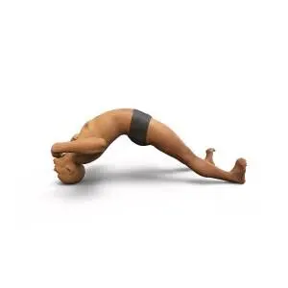
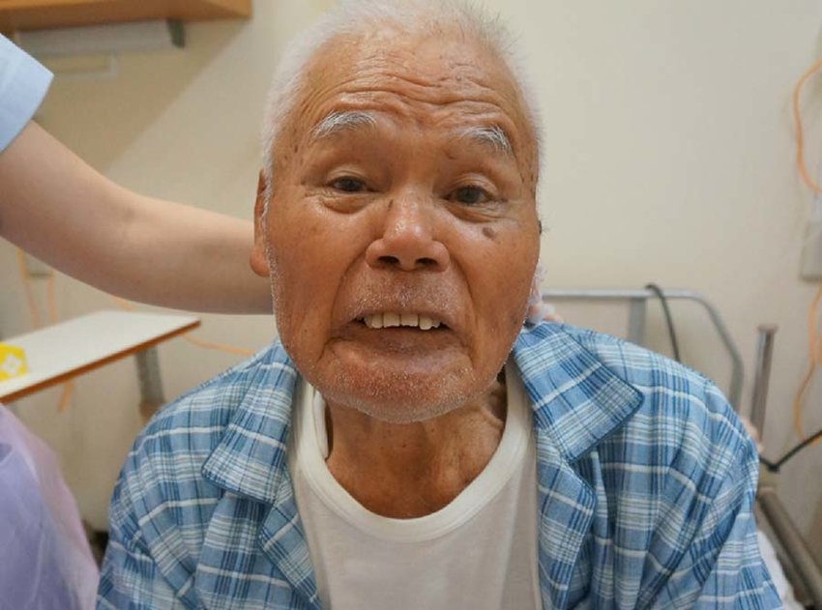
Opisthotonus
Risus Sardonicus

Slide 29
Tetanus: Spasticity + classic signs (lockjaw, risus sardonicus, opisthotonus)
Strychnine: Violent generalized convulsions with clear consciousness between spasms

Slide 30
Polio
Site: Anterior horn motor neurons (Lower Motor Neurons) Defect: Viral destruction of LMNs → axonal degeneration Channel: Not channel-based; neuron loss End result: Flaccid paralysis, muscle wasting
Simple symptoms:
Asymmetric limb weakness
Hypotonia
Hyporeflexia
Muscle atrophy

Slide 31


Slide 32
Motor Neuron Disease
What Happens? (Defect)
Progressive degeneration of both Upper Motor Neurons (UMN) and Lower Motor Neurons (LMN).
Where is the defect?
Cortex (UMN)
Anterior horn cells (LMN)
Corticospinal tracts

Slide 33
Which Channels/Proteins involved?
Not a single channel disease. Common mechanisms include:
Glutamate excitotoxicity (↑ glutamate receptors causing neuronal injury)
SOD1 mutation, TDP-43, FUS protein dysfunction
End Result
Loss of motor neurons → progressive weakness
Combination of UMN + LMN signs
Simple Clinical Features
LMN: muscle wasting, fasciculations, foot drop
UMN: spasticity, brisk reflexes, Babinski positive
Bulbar involvement → dysarthria, dysphagia
No sensory loss (classic point)

Slide 34
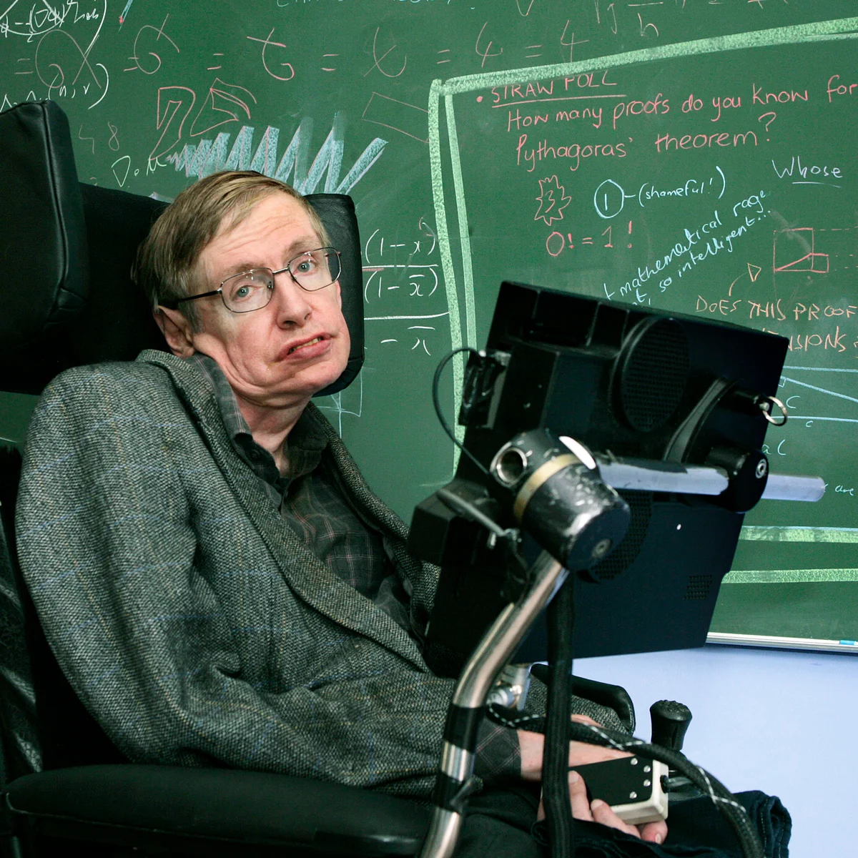

Slide 35
Condition | Site | Channel / Protein Affected | Result | Key Symptoms
Strychnine | Spinal cord (Renshaw cells) | Glycine-gated Cl⁻ receptor | No inhibition → spasms | Severe rigidity, convulsions
Tetanus | CNS inhibitory interneurons | Synaptobrevin (VAMP) in inhibitory neurons | ↓ GABA & glycine → spasticity | Lockjaw, risus sardonicus, opisthotonus
Organophosphate Poisoning (AChE inhibitors) | Synaptic cleft (ACh breakdown) + CNS + autonomic ganglia | Acetylcholinesterase (AChE) inhibited (no breakdown of ACh) | ↑ ACh → Cholinergic crisis | DUMBBELSS, miosis, bronchospasm, fasciculations, paralysis
Botulism | Pre-synaptic NMJ | SNARE proteins (Synaptobrevin, SNAP-25) | No ACh release | Descending flaccid paralysis
Botox | Pre-synaptic NMJ | SNARE proteins | Local ACh blockade | Local muscle relaxation
LEMS | Pre-synaptic NMJ | P/Q-type Ca²⁺ channels | ↓ Ca²⁺ entry → ↓ ACh release | Weakness improves with use
MG | Post-synaptic NMJ | Nicotinic ACh receptors | ↓ end-plate potential | Fatigability, ptosis, diplopia
Diptheria | Peripheral nerves (myelin) | EF-2 inhibition → impaired protein synthesis → demyelination | Conduction block | Bulbar palsy, limb weakness
Polio | LMN cell bodies | — (viral destruction of anterior horn cells) | LMN neuron loss | Flaccid paralysis, hyporeflexia
Motor Neuron Disease | UMN + LMN | Glutamate excitotoxicity, SOD1/TDP-43 dysfunction | Mixed UMN + LMN degeneration | Wasting + fasciculations + spasticity

Slide 36
Thank You

